Slide 1
DSP SOP of MCC Data
By Gabriel Fonseca

Slide 2
About the data
MCC samples
Cancer immunotherapy
Anti PD-1 treatment
Nivolumab (Opdivo)
Progressor vs non-progressor
4 slides total
1800 genes
Filtered
Negative probe count

Slide 3
Quality Control
Signal to noise ratio
Log normalization
Q3 normalization
Panel analysis
Clustering (PCA)

Slide 4
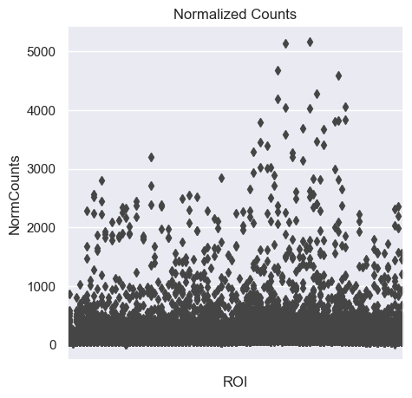
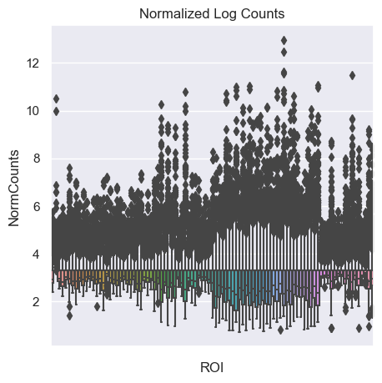
Q3 Normalization

Slide 5
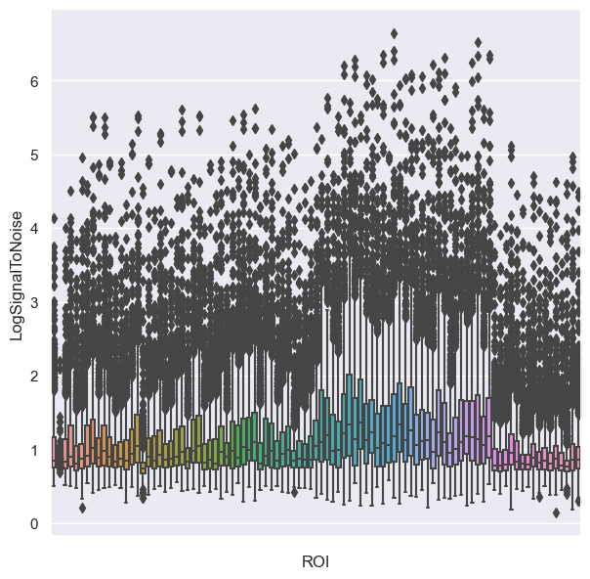
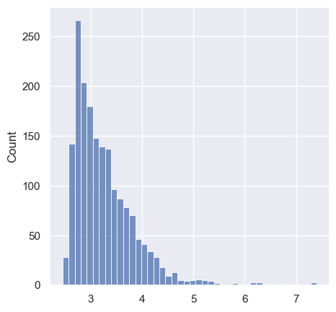
Log Normalization

Slide 6
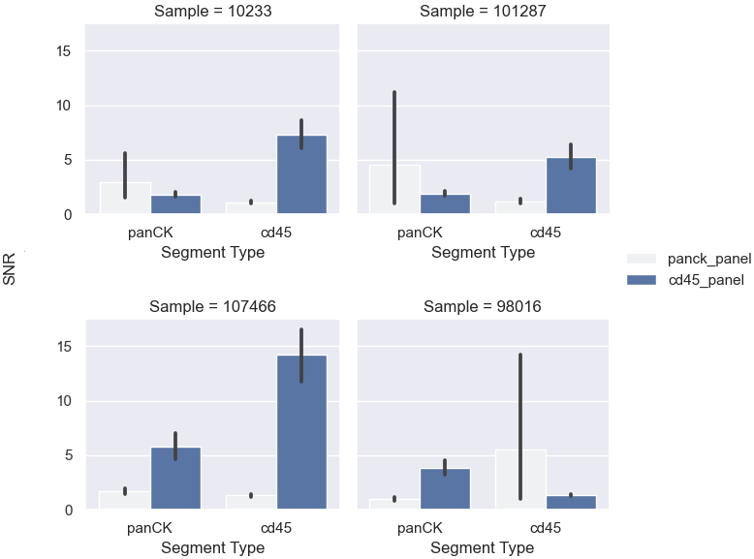
Segment Signature Analysis

Slide 7
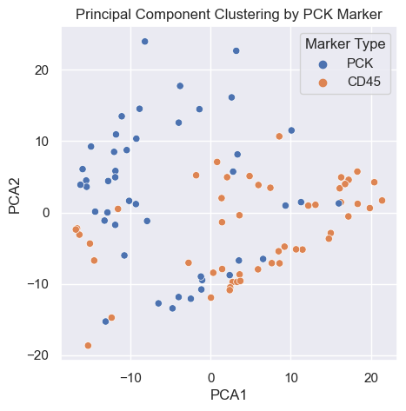
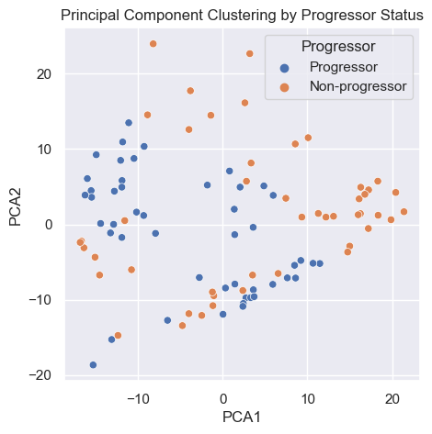
Clustering by PCA

Slide 8
DGE Analysis
Cell type deconvolution
Differential gene expression
Volcano plots
Heatmaps
Pathway analysis

Slide 9
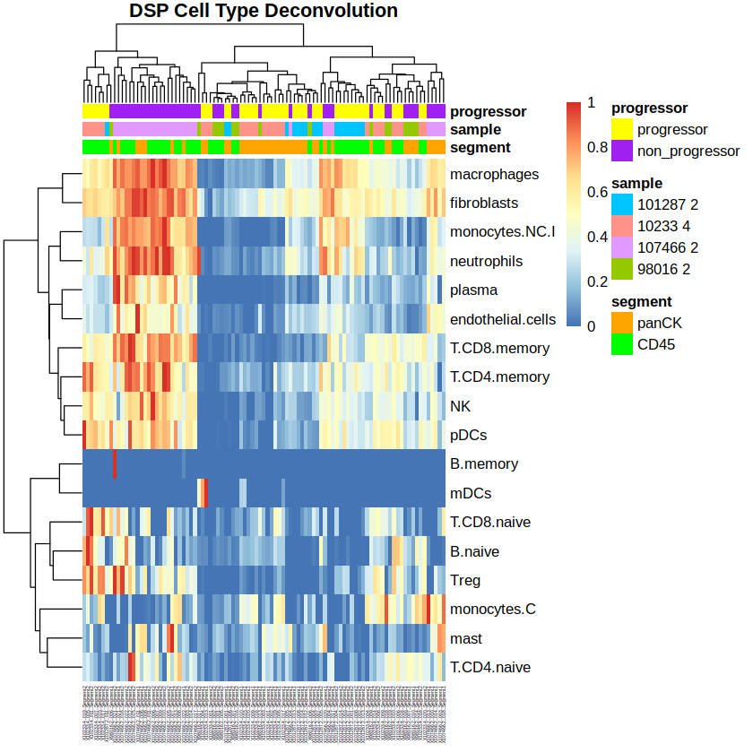
Cell Deconvolution

Slide 10
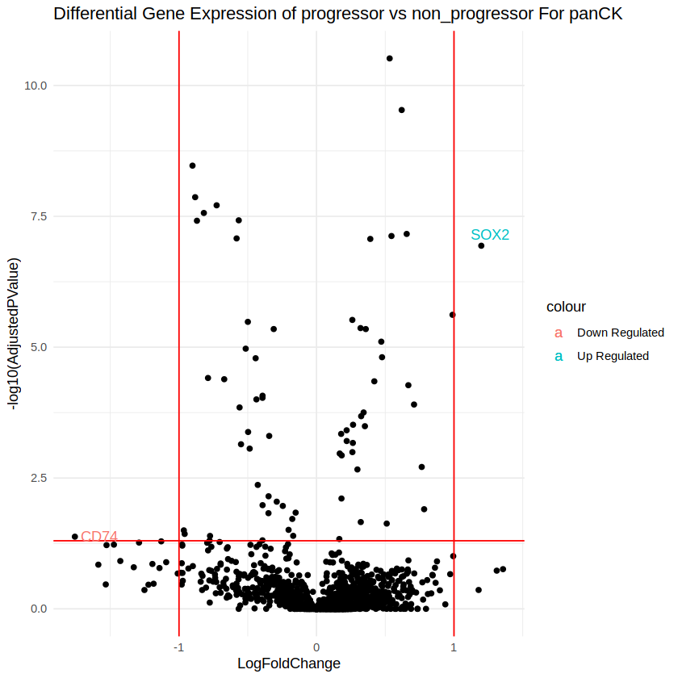
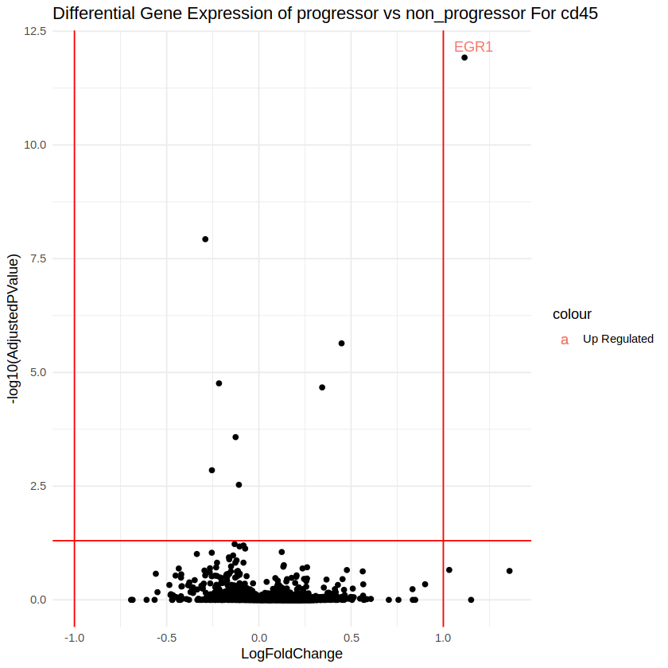
Volcano plots

Slide 11
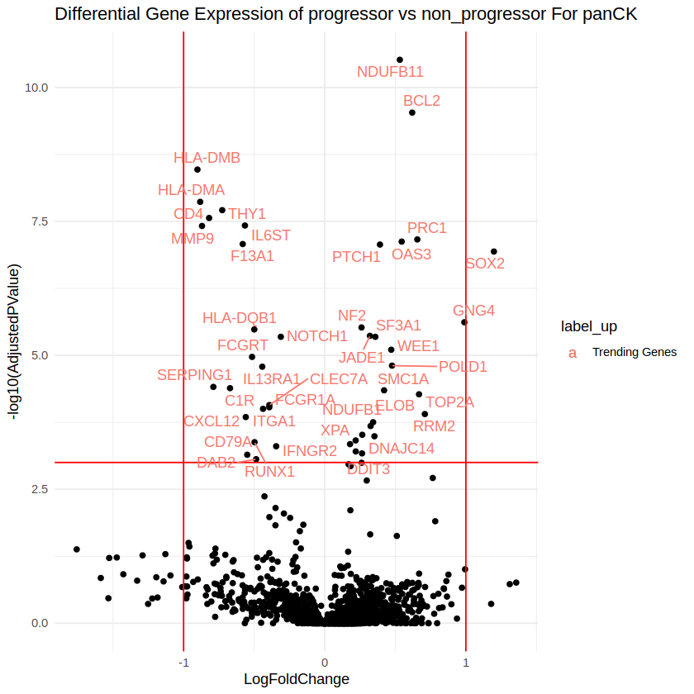
Volcano plot – trending genes

Slide 12
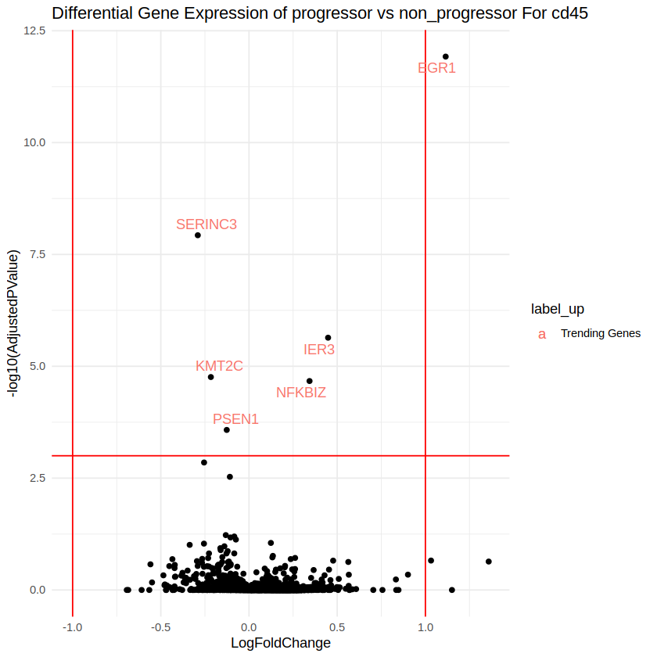
Volcano plot – trending genes

Slide 13
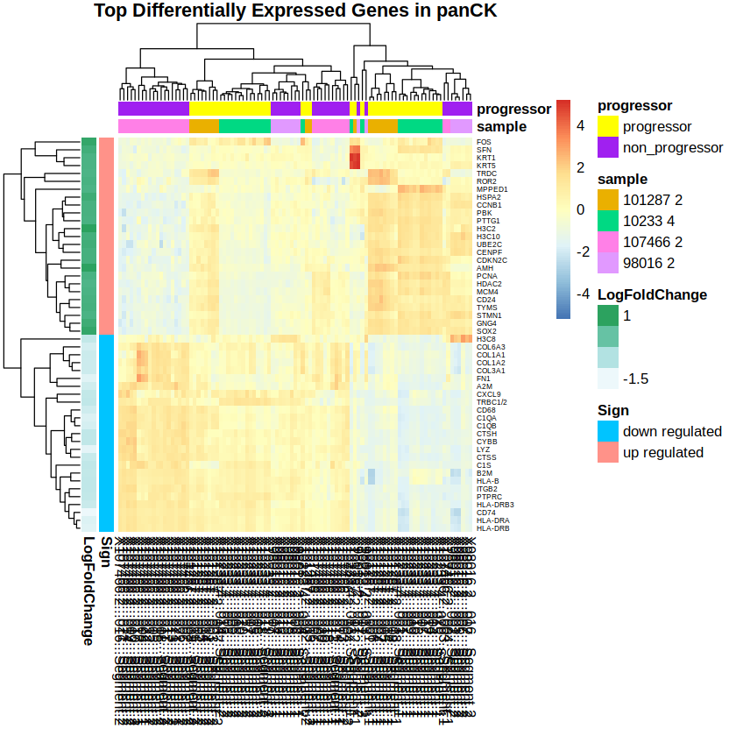
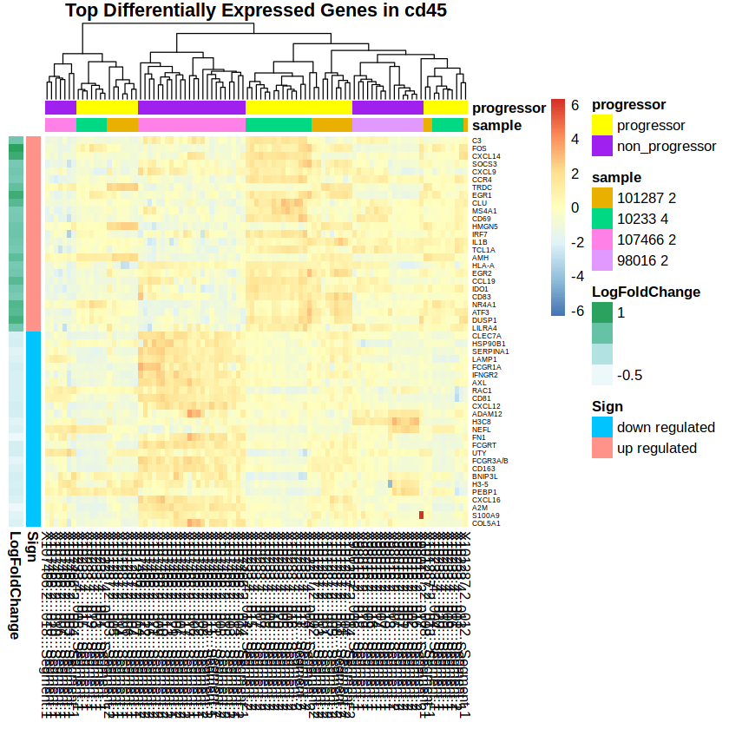
Heatmaps

Slide 14
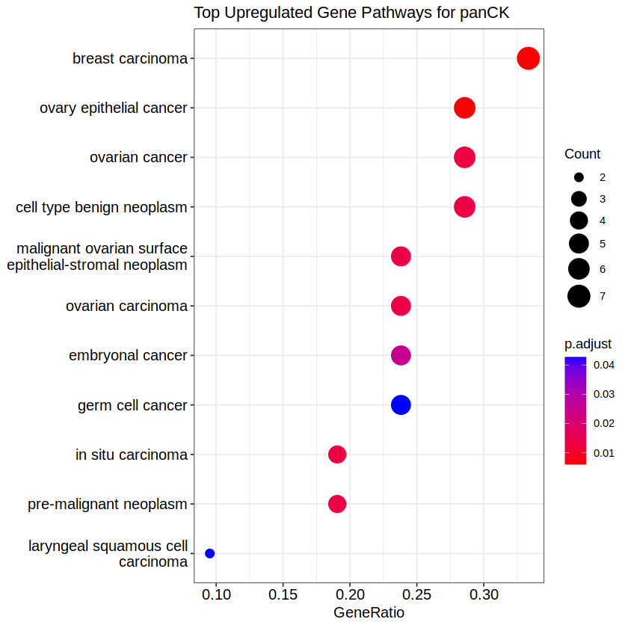
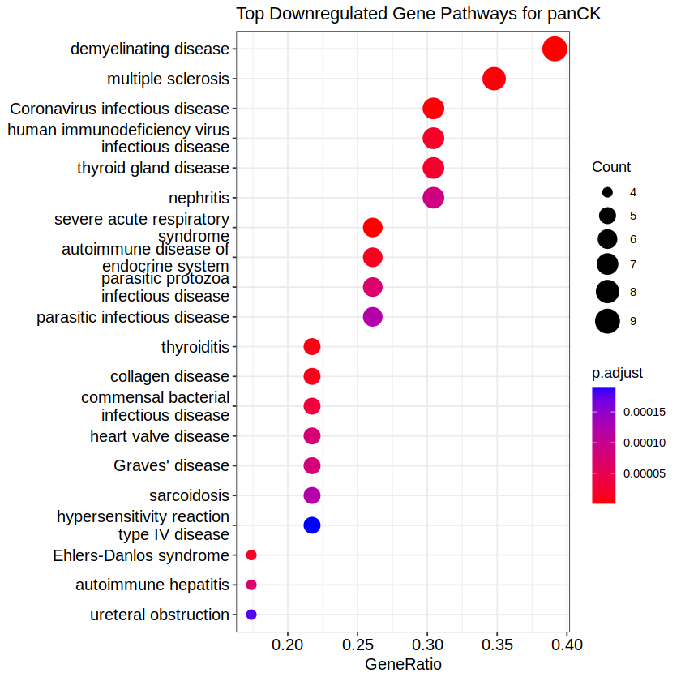
Pathway Analysis – panCK

Slide 15
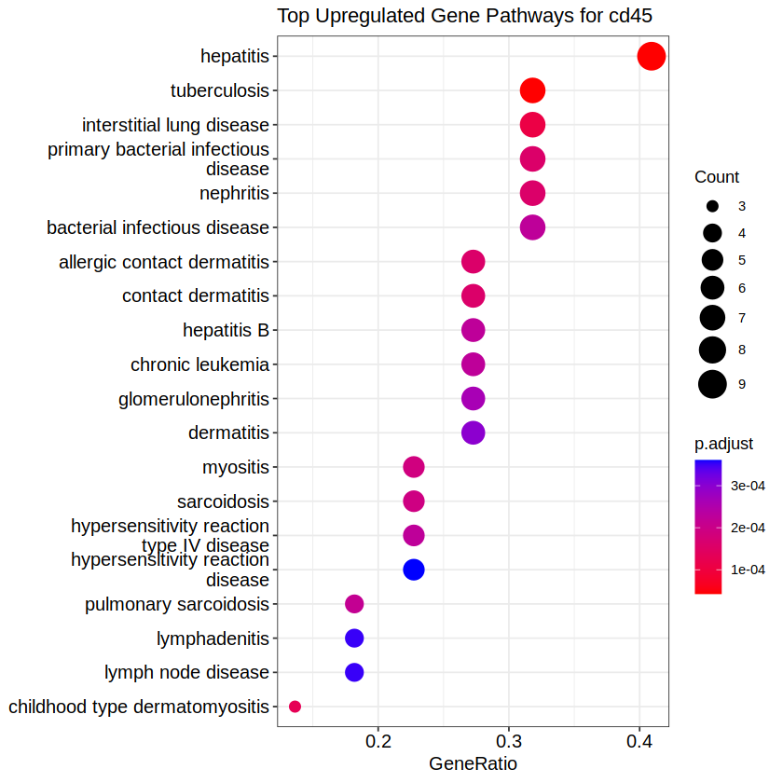
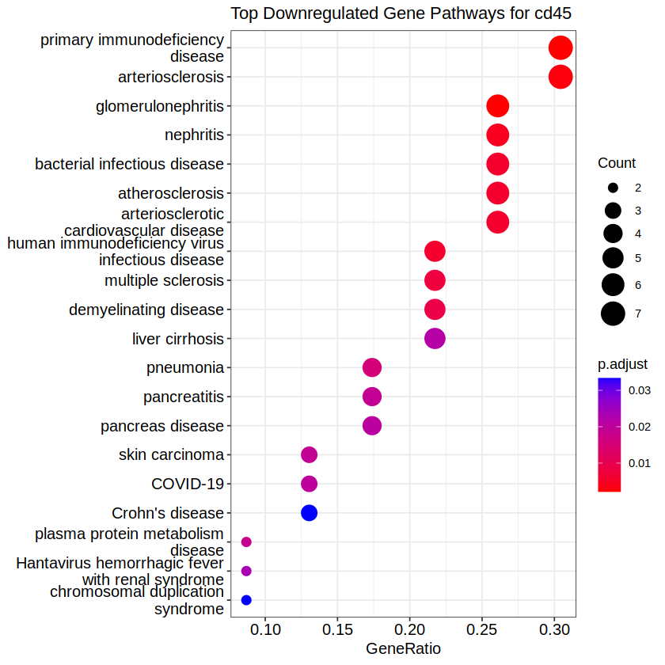
Pathway Analysis – cd45

